Slide 1

Computer Organization and Assembly Language
Lecture 2
Amir Nawaz

Slide 2
Today we will learn?
Bus and Its types
Flowchart of conversion of High Level to Assembly then Machine Language
Why we need Register their comparison with other memory location
Register
What is the purpose of register
Types of register

Slide 3
Bus
In computer architecture, a bus is a collection of wires, chips, and slots inside the computer through which data are transmitted from one part of the computer to another to and from (in and out) from peripheral devices. It is often compared to a highway (pathways in the computer on which data travels). It is a set of parallel distinct wires, serving different purposes, which allow devices attached to it to communicate with the CPU.
The function of the bus are:
It carries information from one component to another.
It carries data, addresses, or control signals.
One component of the component can interact with others by bus.

Slide 4
Types/Parts of bus
Control bus
Address bus
Data bus

Slide 5
Control Bus:
The control bus carries the control signal. The control signal is used for controlling and coordinating the various activities across the computer. It is generated from the control unit within the CPU. Different architectures result in a differing number of lines of wires within the control bus, as each line is used to perform a specific task. For instance, different specific lines are used for each of the read, write, and reset requests. These are not a group of lines like address bus and data bus, but individual lines that provide a pulse to indicate a microprocessor operation. The control unit generates a specific control signal for every operation, such as memory read or input/ output operation. This signal is also used to identify a device type, with which the microprocessor intends to communicate.

Slide 6
Address Bus:
The address bus carries a memory address within the device. It allows the CPU to reference memory locations within the device. It connects the CPU and other peripherals and carries only memory addresses. In a computer system, each peripheral or memory location is identified by a numerical value, called an address and the address bus is used to carry this numerical value as well as it also contains a few control lines to carry control commands. The processor uses the address bus to perform, identifying a peripheral or a memory location. The address bus is unidirectional, bits flow in one direction, from the processor to a peripheral or a memory location.

Slide 7
Data Bus:
Data bus transfers data from one location to another across the computer. The meaningful data which is to be sent or retrieved from a device is placed on these lines. The CPU uses a data bus to transfer data. It may be a 16-bit or 32-bit data bus. It is an electrical path that connects the CPU, memory, and other hardware devices on the motherboard. These lines are bidirectional, data flow in both directions between the processor and memory and peripheral devices.

Slide 8
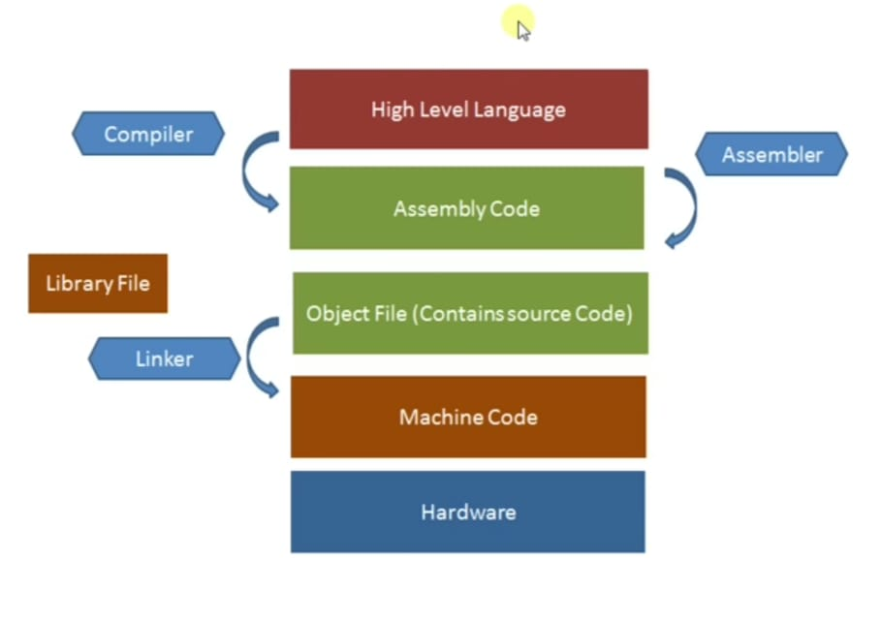

Slide 9
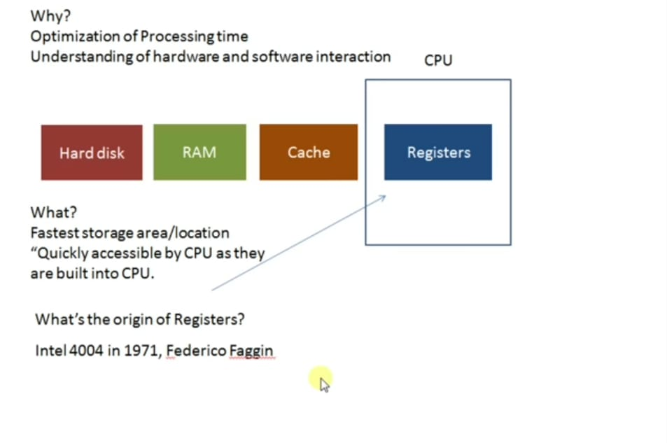

Slide 10
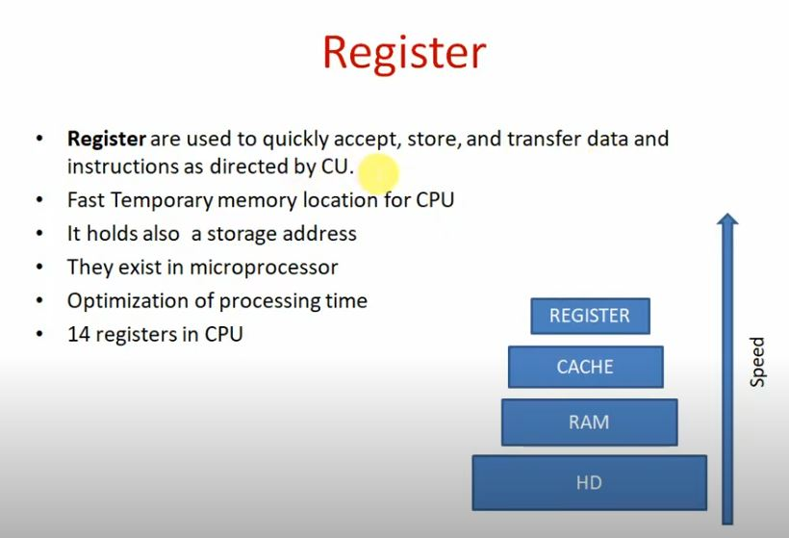

Slide 11
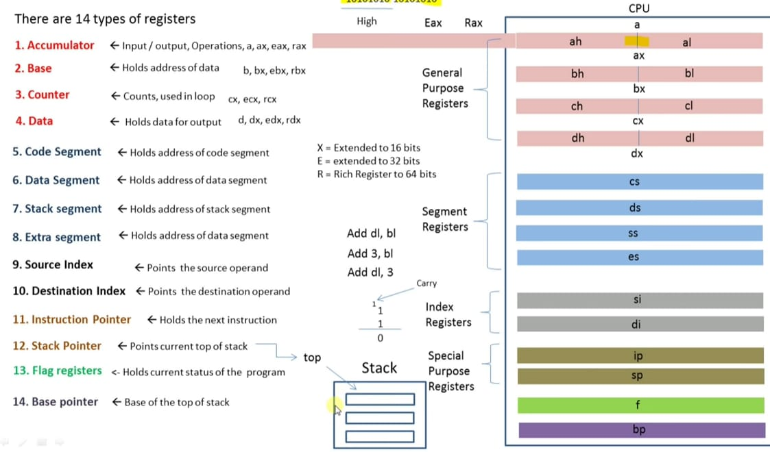

Slide 12
These are the registers that an assembly language programmer can directly work with using instructions.
A. General-Purpose Registers (GPRs)
Purpose: Designed to hold temporary data, intermediate results, and memory addresses. They are the "workhorses" of the CPU.
Explanation: Their name is slightly misleading because they are not truly general. While they can be used for various tasks, certain conventions and instructions may favor specific GPRs for special roles (e.g., ECX being used as a loop counter in x86, or AX being used for arithmetic).
Examples:
  x86-64: RAX, RBX, RCX, RDX, RSI, RDI, R8-R15.
  ARM: R0-R12.
  MIPS: $t0-$t9 (temporaries), $s0-$s7 (saved variables).

